Slide 1

Akash Bhargav Dept. of Mechanical Engineering IIT Kanpur

Slide 2
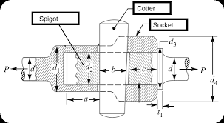
DESIGN AND ANALYSIS OF COTTER JOINT

Slide 3
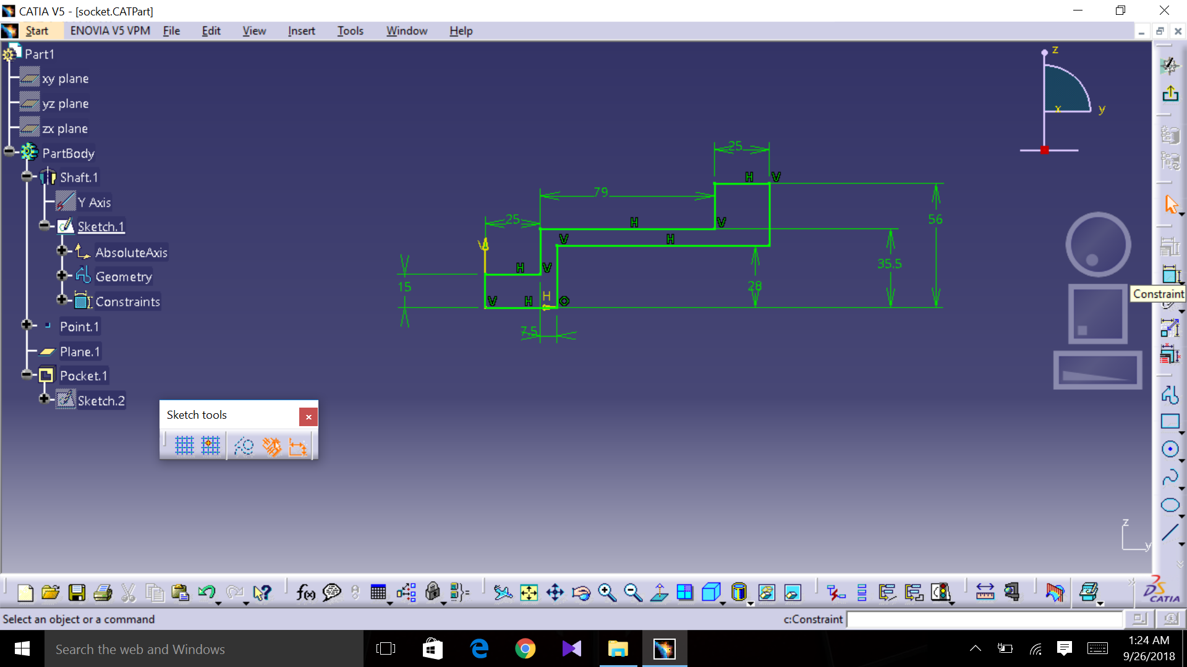
SOCKET PART

Slide 4
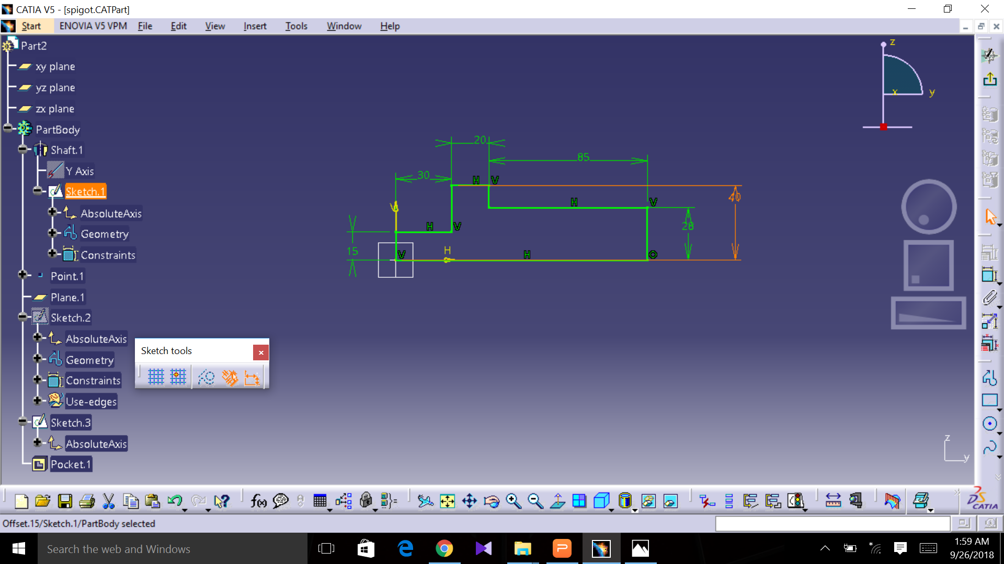
SPIGOT PART

Slide 5
DIMENSIONS:
d2=inside diameter of the socket = 56
d1=outside diameter of socket collar=71mm
d=diameter of rods=30mm
d3=diameter of spigot collar=80mm
t=thickness of cotter=6mm
l=length of cotter=120mm
b=mean width of cotter=22mm

Slide 6
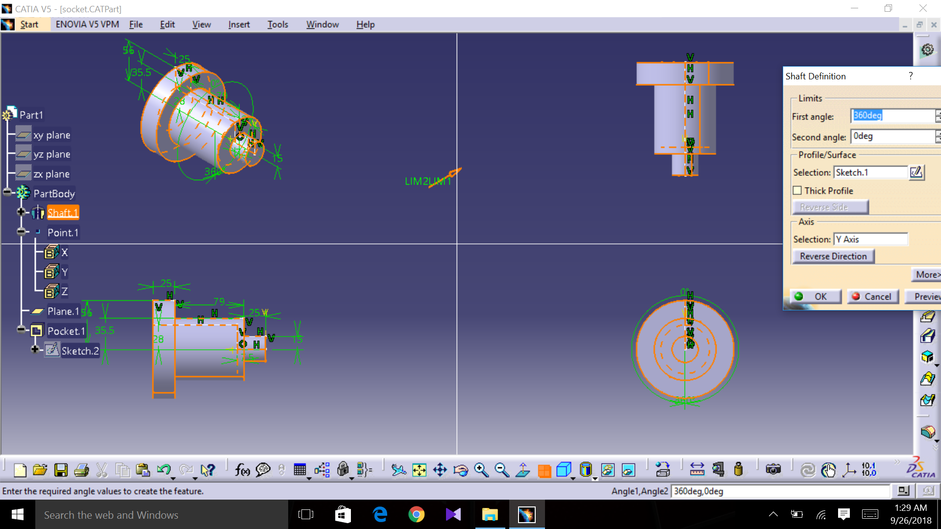
SPIGOT DESIGNING

Slide 7
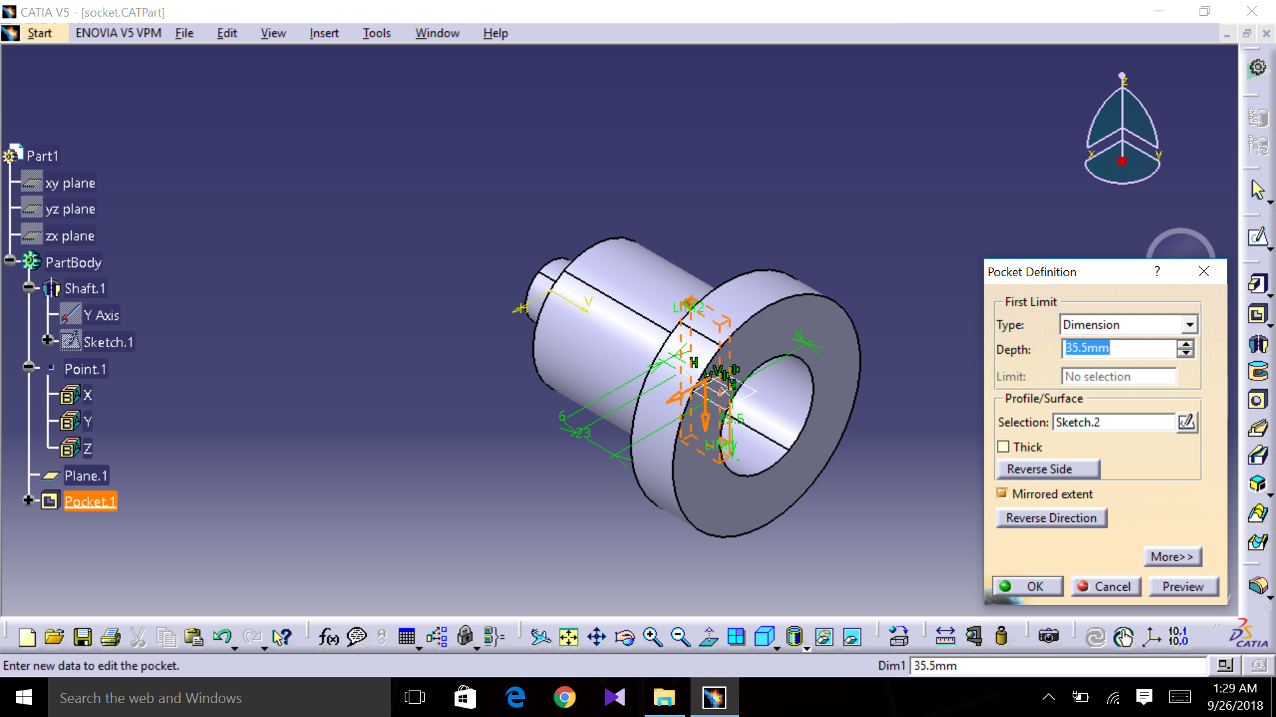

Slide 8
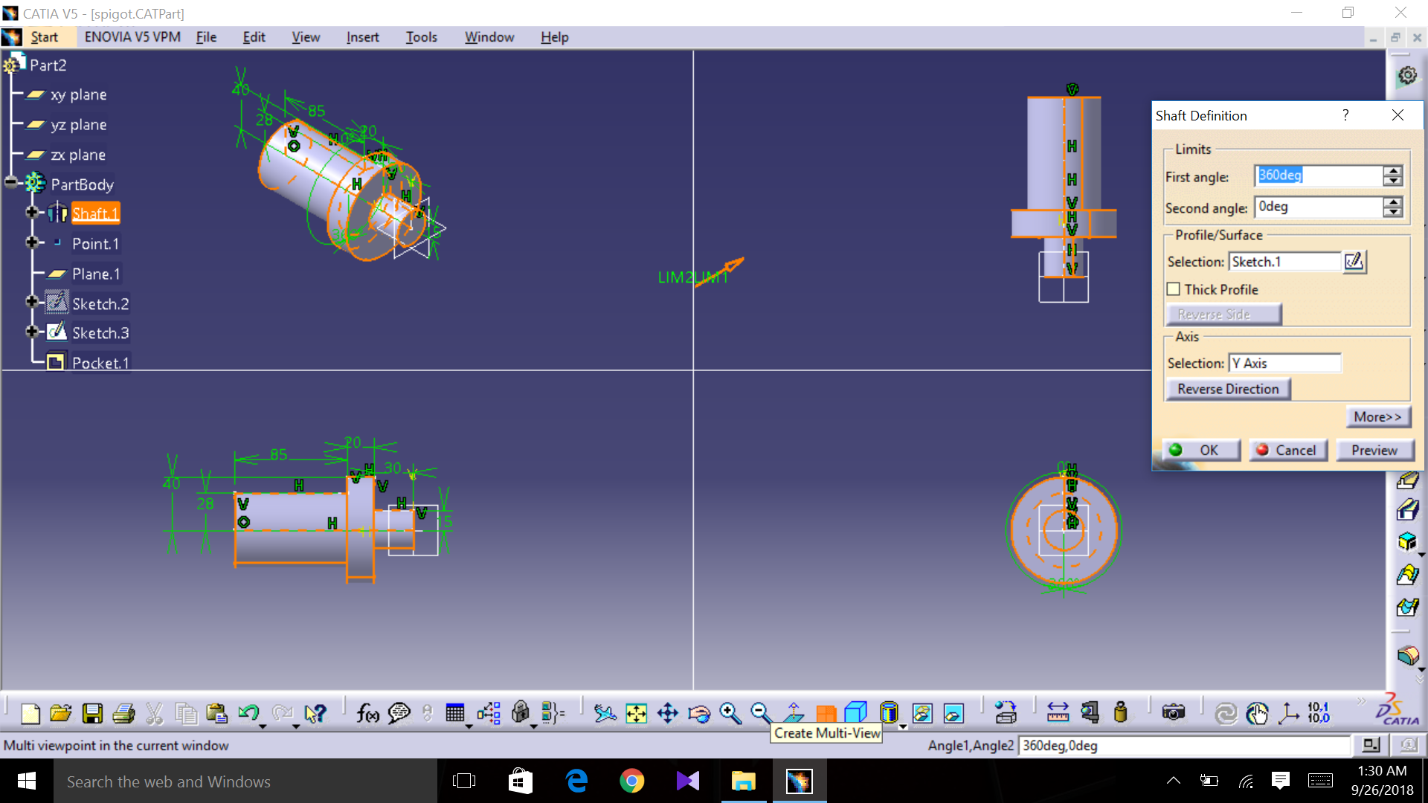
SOCKET DESIGNING

Slide 9
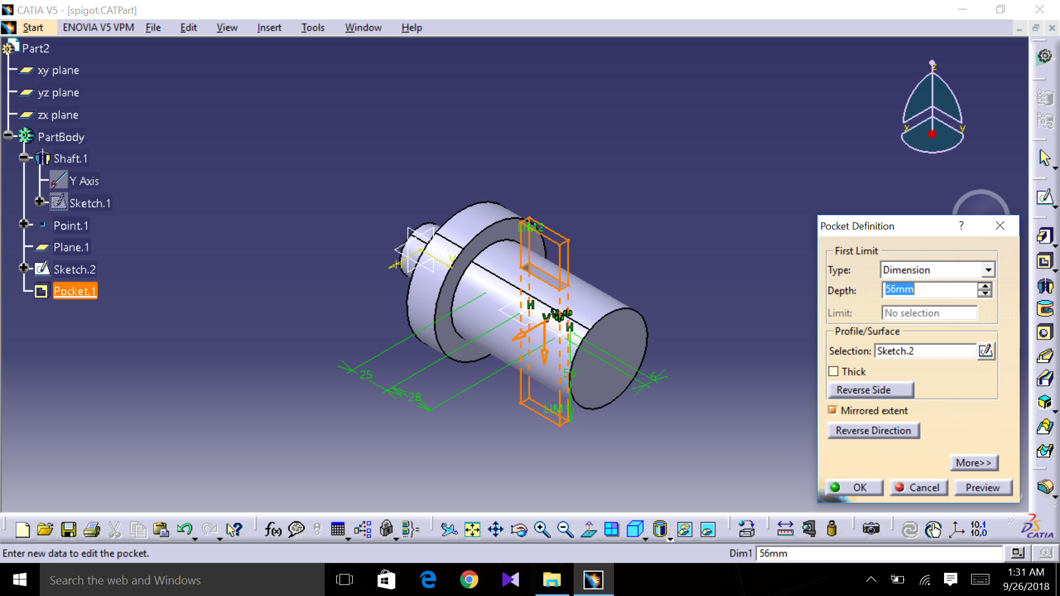

Slide 10
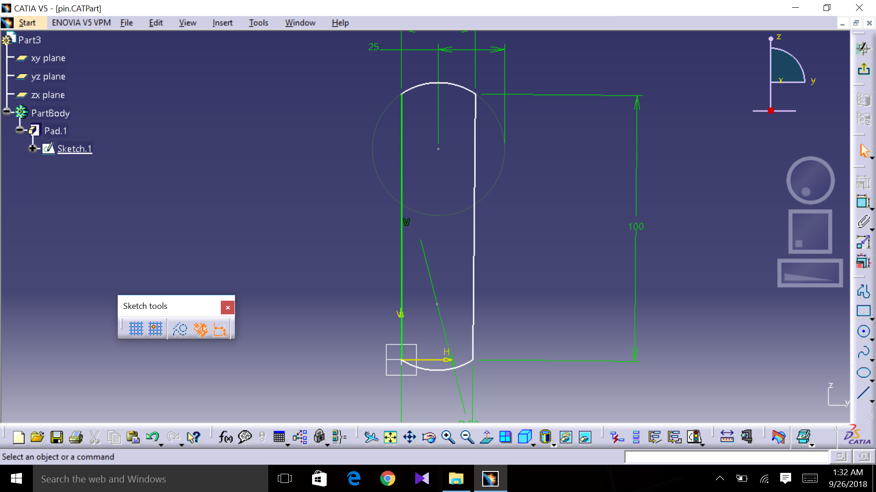
PIN PART DESIGNING

Slide 11
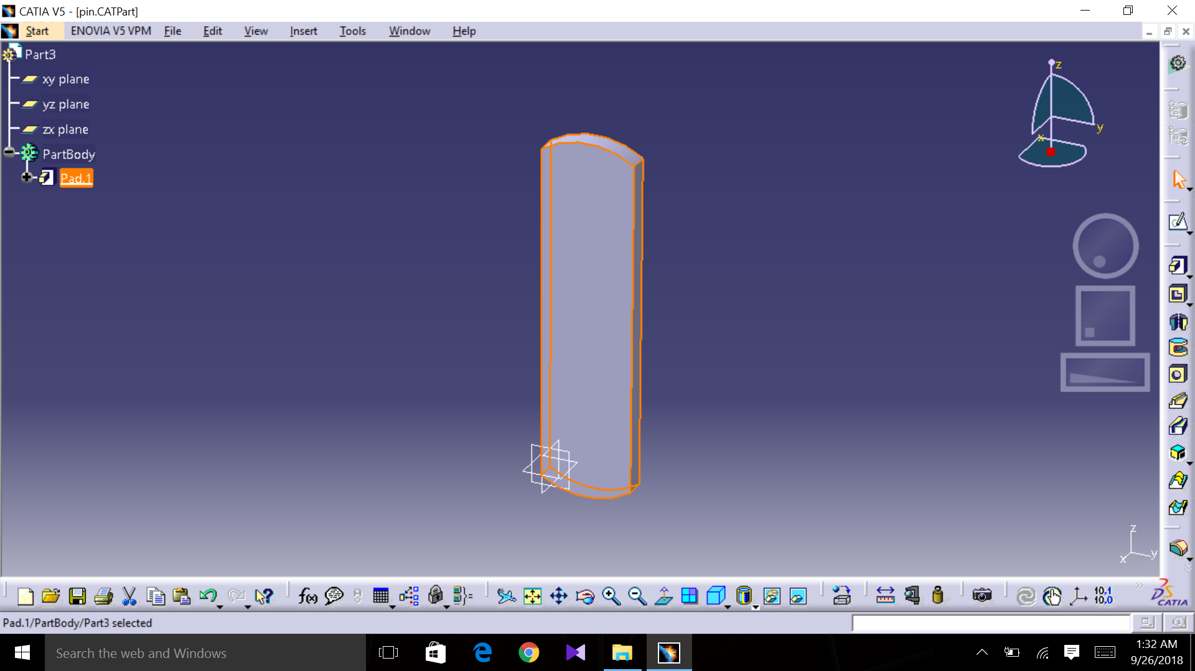

Slide 12
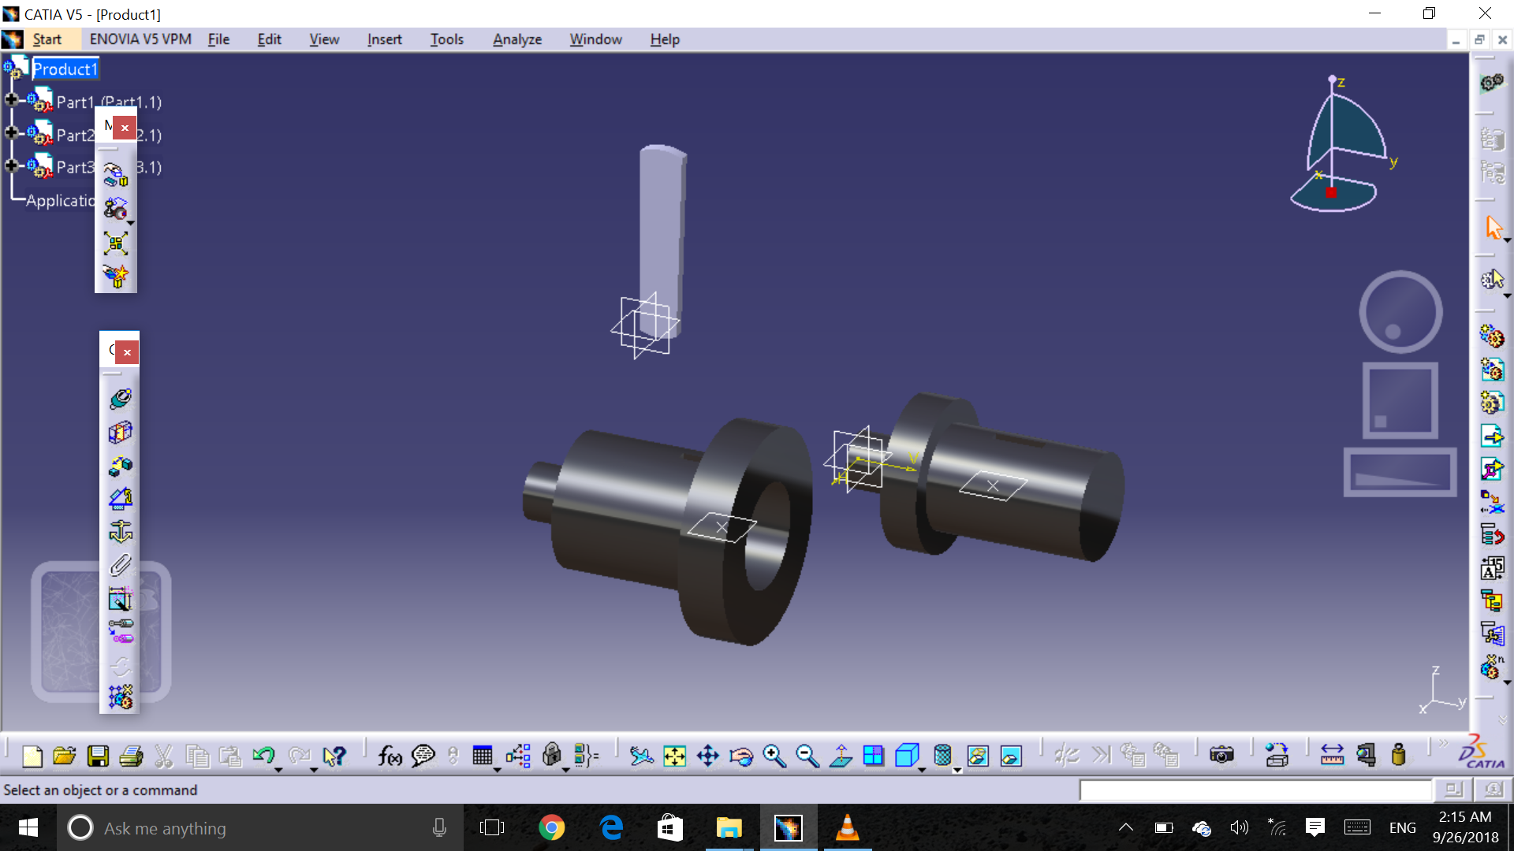
SOCKET AND SPIGOT COTTER JOINT

Slide 13
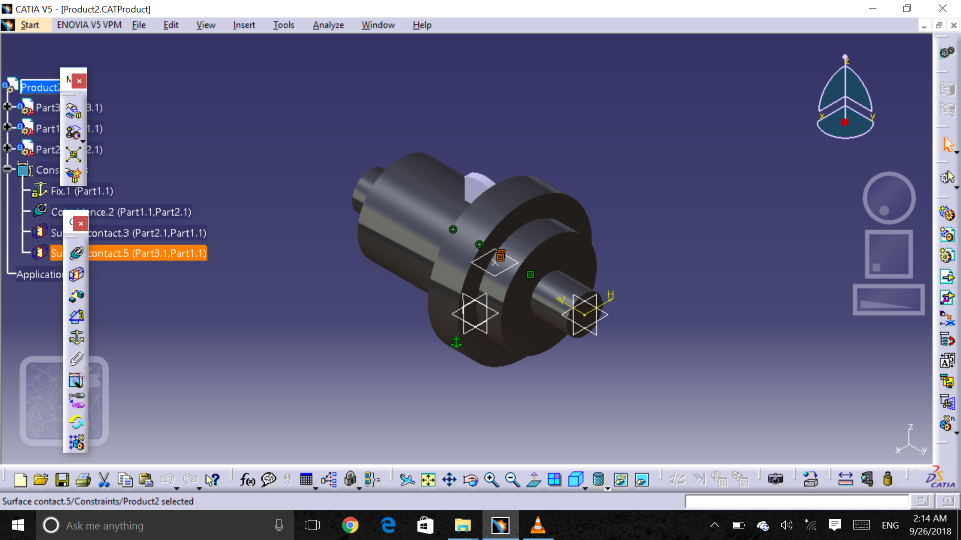

Slide 14
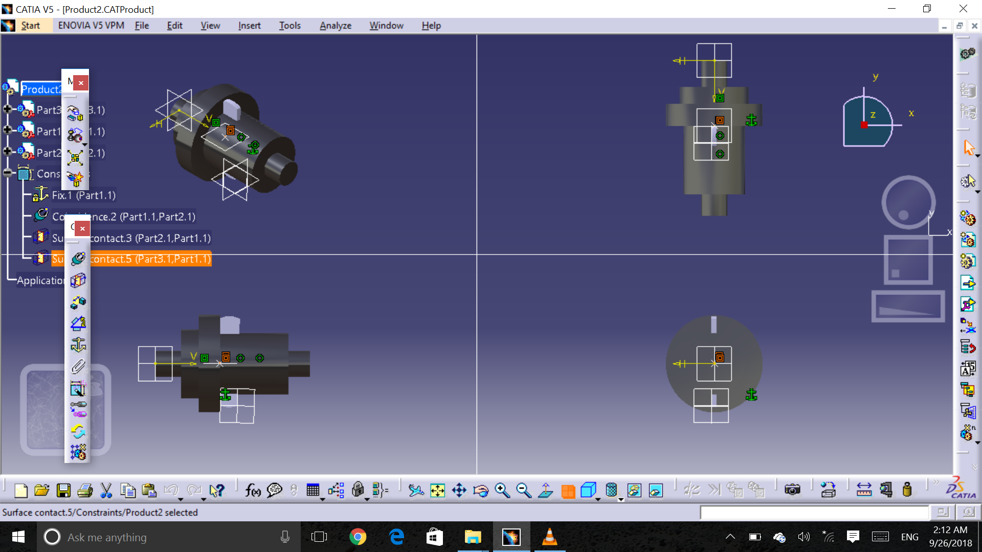

Slide 15
ANALYSIS
OF
COTTER JOINT

Slide 16
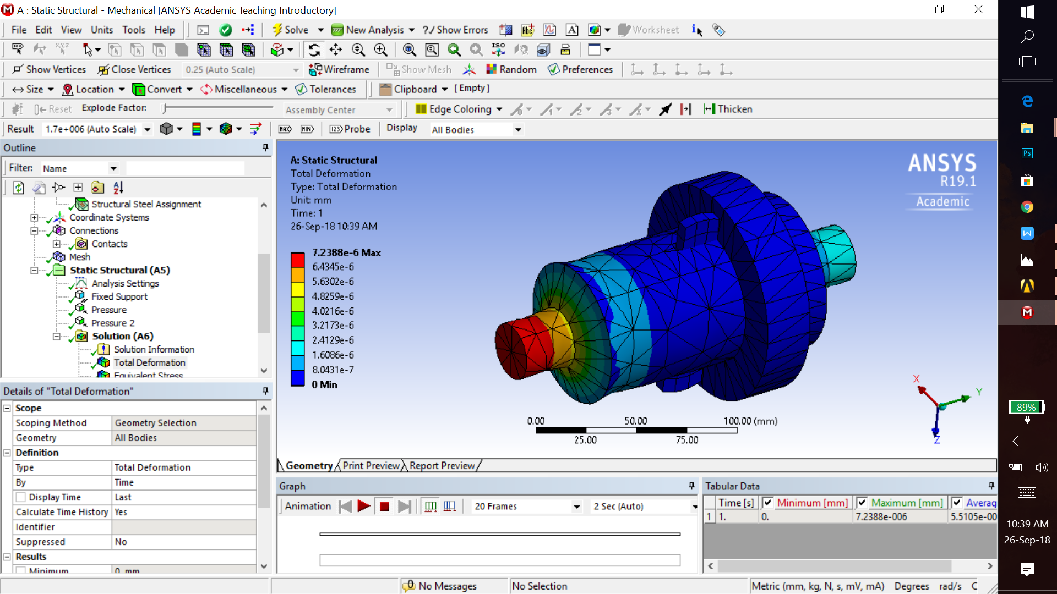
Analysis of Total deformation

Slide 17
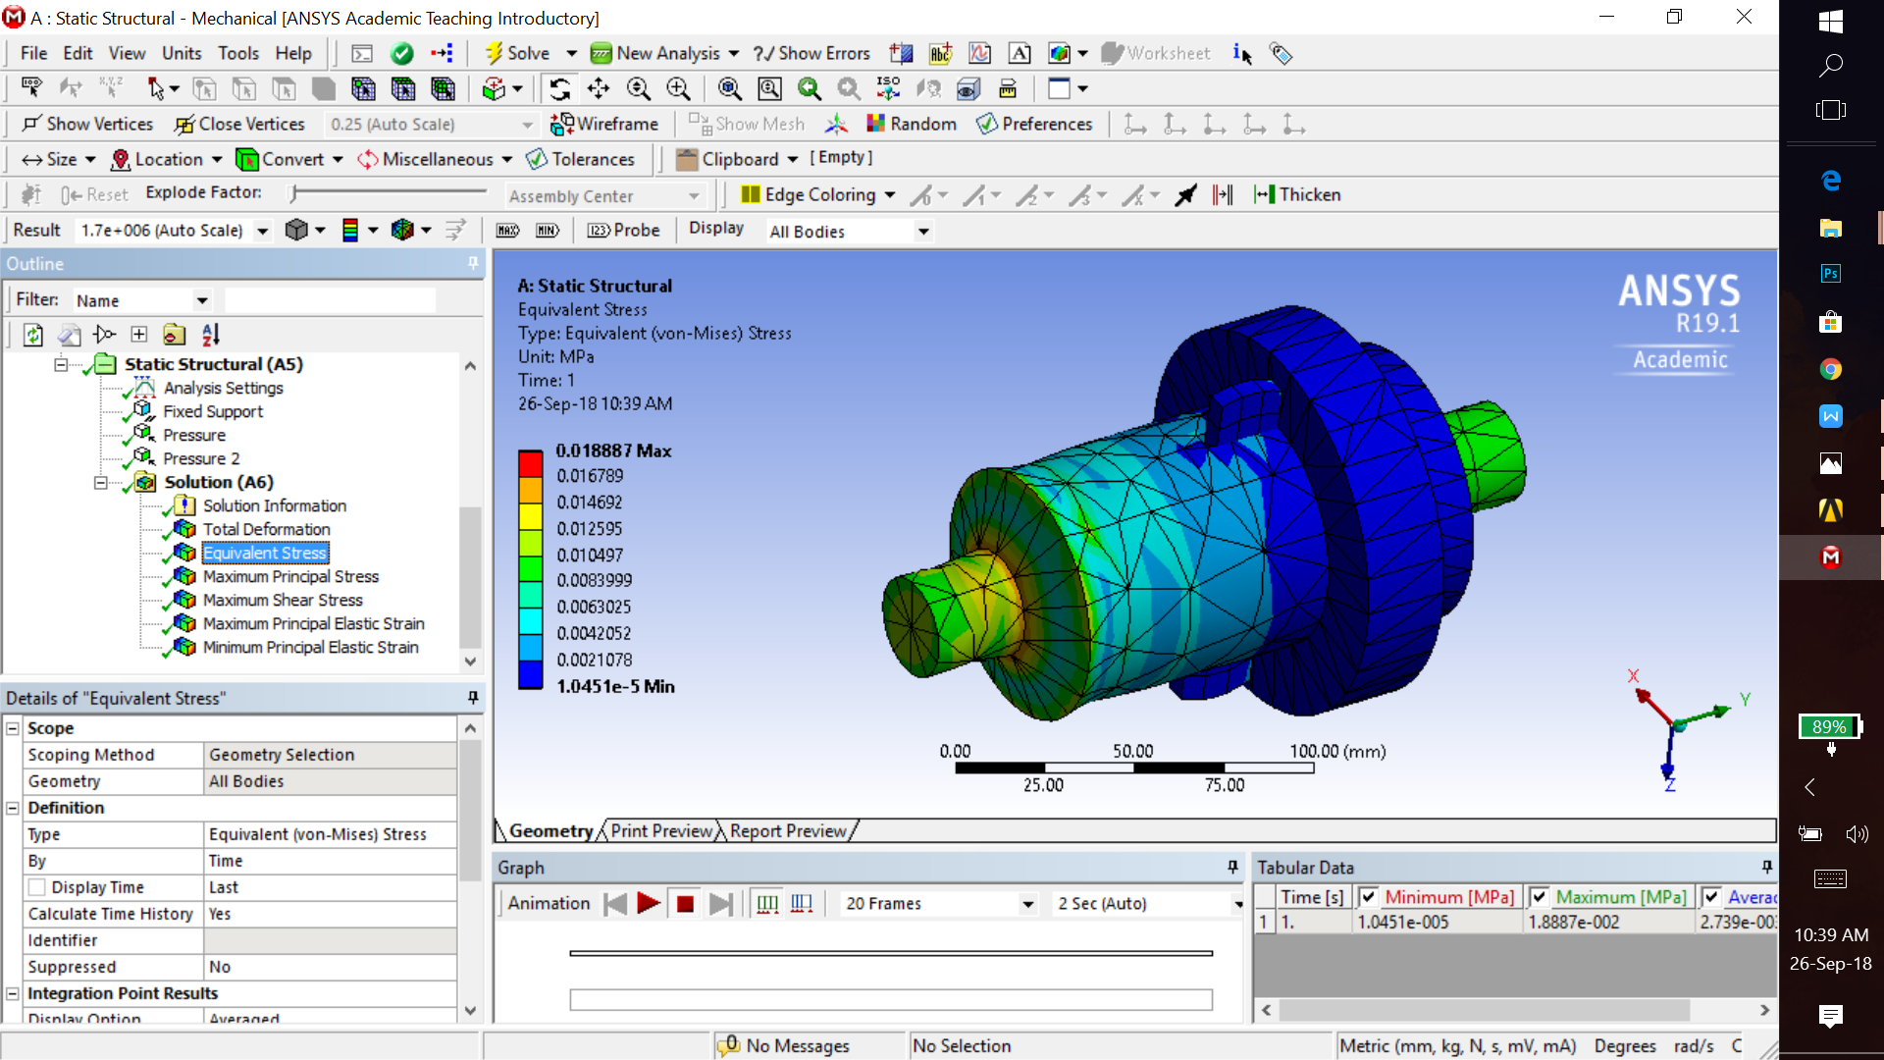
Analysis Of Equivalent Stress

Slide 18
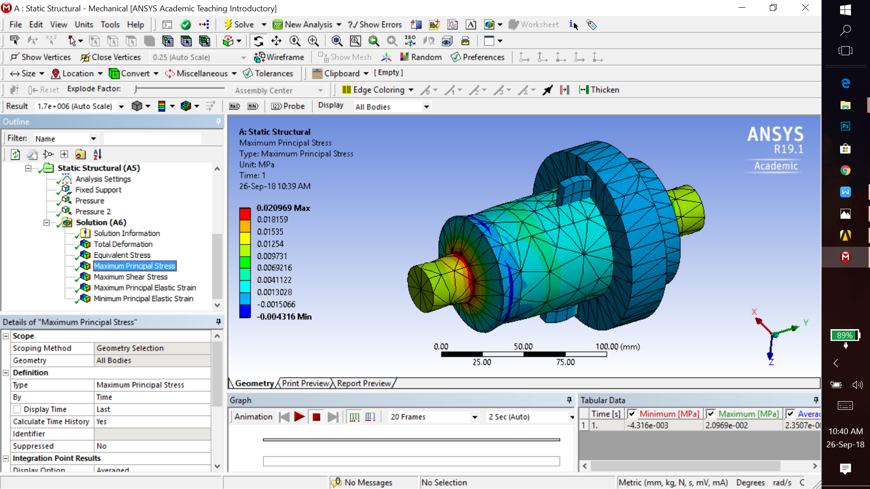
Analysis Of Maximum Principal Stress

Slide 19

Analysis Of Maximum Shear Stress

Slide 20

Analysis Of Maximum Principal Elastic Strain

Slide 21
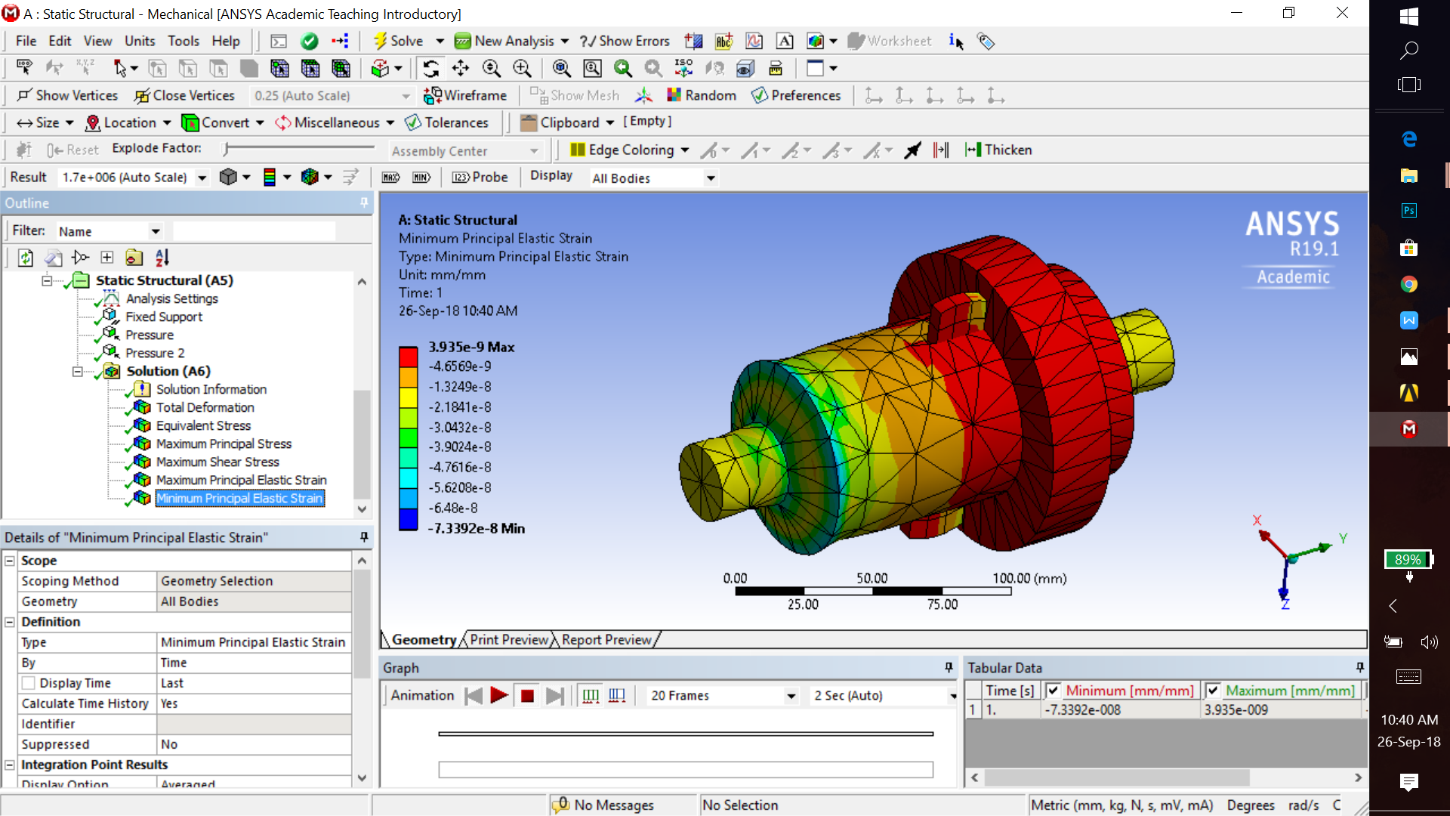
Analysis Of Minimum Principal Elastic Strain

Slide 22
THANK YOU!!!

